Slide 1
Day17 ppt
writing program with guidelines

Slide 2
Guidelines to be followed while writing programs
File Naming: The source file is named example.c following the convention of using the .c extension for C source files.
Header Inclusion: The #include <stdio.h> directive incorporates the standard input/output library for functions like printf.
Indentation: Consistent indentation (usually 4 spaces) enhances code readability and reflects code structure. Indentation levels increase within code blocks (functions, loops, conditionals).
Whitespace: Spaces are used around operators (+, -, etc.) and after commas for better separation. Blank lines improve readability between functions and logical sections.Meaningful.
Variable Names: Descriptive variable names like num1, num2, and sum convey their purpose. Avoid single-letter names unless absolutely necessary.Function .
Prototypes (Optional): For larger projects, declaring functions before main using int add(int x, int y); helps with modularity and error checking during compilation. In smaller examples like this, it's not strictly required.

Slide 3
Guidelines to be followed while writing programs
Comments: Comments explain the code's functionality and intent. Here, comments describe the purpose of functions (add, print_message).
Constant Strings: The message in print_message is declared as a constant string (const char *message) to prevent accidental modification.
Function Return Types: Functions clearly indicate their return types (int add, void print_message).
Return Statements: Functions return values using return statements (return result in add). main returns 0 to signal successful program termination.Line
Length: Keeping lines under 80 characters improves readability.
Braces for if Statements: Even for single-line if statements, use braces ({}) for clarity and potential future additions.

Slide 4
Guidelines to be followed while writing programs
Header Guard: The #ifndef and #define directives with EXAMPLE_H_ create a header guard to prevent multiple inclusions of the same header file, ensuring code is compiled only once.extern .
Keyword: Function prototypes use the extern keyword to declare their existence without providing definitions. This avoids violating the MISRA C rule against function definitions in header files (Rule 8.5).const
Qualifier: The const char *message parameter in print_message explicitly declares the string pointer as constant, preventing accidental modification within the function, which aligns with MISRA C's preference for avoiding undefined behavior (Rule 13.7).

Slide 5
Benefits of following guidelines
Consistency: Guidelines help maintain a consistent coding style throughout the project or organization. This consistency makes the codebase easier to read and understand for developers, leading to improved collaboration and reduced maintenance overhead.
Readability: Following guidelines results in code that is easier to read and comprehend. Clear and consistent formatting, naming conventions, and commenting practices enhance the readability of the code, making it easier for developers to understand its functionality and logic.
Maintainability: Well-structured code, adhering to guidelines, is easier to maintain and modify. Consistent code formatting, modular design, and meaningful variable names facilitate code maintenance tasks, such as debugging, refactoring, and adding new features.
Reduced Errors: Guidelines often include best practices and coding standards that help prevent common programming errors. By following these guidelines, developers can avoid pitfalls and write more robust, error-free code.

Slide 6
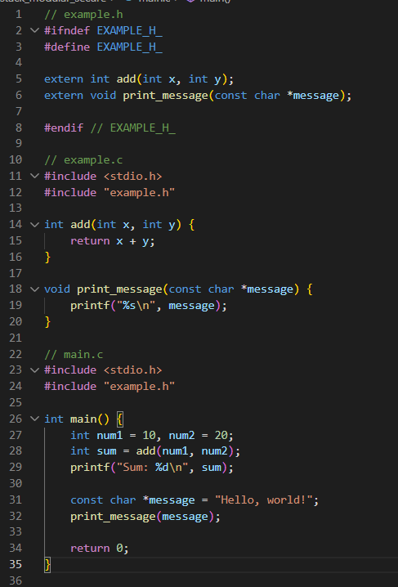
Program following guidelines

